Slide 1



Route 132 Improvements Project – Public Information Meeting
Presented by
Paul Graves, pe
Steve Rhoads, pe
January 29, 2024
Notes:
Cover Option 2

Slide 2
Presentation Outline
Project Area & Limits
Project Status, Existing Issues & Goals
Next Steps
Questions & Answers

Slide 3
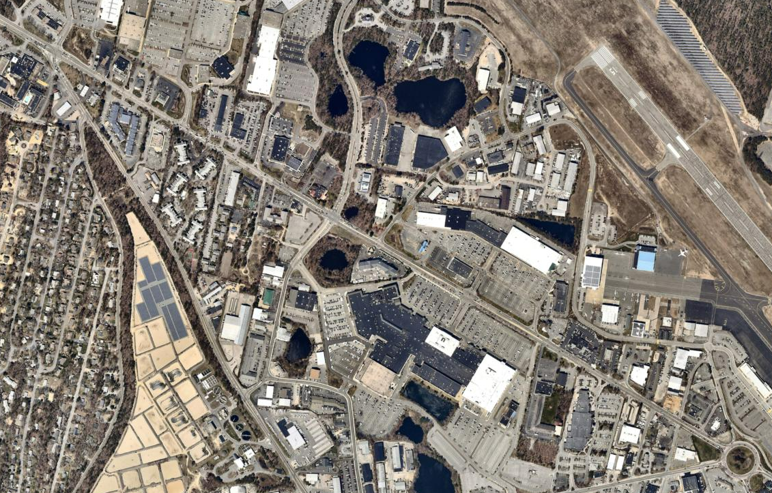
Route 132 Improvements
Project Limits
Route 132
Independence Drive
Bearses Way
Route 132
Cape Cod Mall
Project Limits
Airport
Rotary
Airport Rotary not included in Project limits
Study Area – Regional View – Feasibility Study Options
Notes:
Route 132 serves as the primary connection between the limited-access Route 6 highway in the west and Hyannis village in the east. As the primary connection to/from Hyannis village, Route 132 serves as a main route for emergency vehicles accessing the Cape Cod Hospital in Hyannis as well as a main route to access the Cape Cod Gateway Airport and the ferry terminals with service to Nantucket and Martha’s Vineyard.
Land use adjacent to Route 132 within the study area is primarily commercial. Route 132 provides access to one of the largest shopping regions on Cape Cod with the Cape Cod Mall, Capetown Plaza, Festival Plaza, Southwind Plaza, and Christmas Tree Shops Plaza all containing numerous businesses that attract locals and visitors from throughout the region. The corridor also includes several restaurants and hotels that attract diners and tourists. In addition, the corridor provides access to industrial and office areas north of Route 132 along Independence Drive as well as to the Cape Crossroads residential development east of Bearse’s Way.

Slide 4
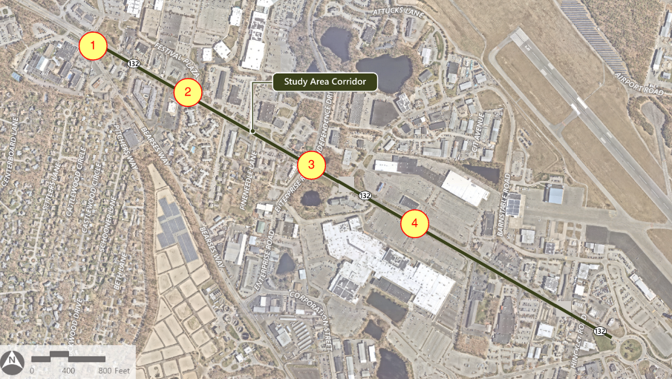
Signalized Intersections

Slide 5
Project Status
Performed traffic counts – completed Summer 2022
Performed road safety audit – completed February 2023
Project traffic & corridor report - ongoing
Public outreach program – 1st meeting tonight
Begin survey – TBD
Begin preliminary design – TBD
Long term project – Construction TBD
Notes:
Traffic and corridor report – detail existing & future conditions; review active transportation and transit facilities throughout the corridor

Slide 6
Existing Issues – Route 132
Inconsistent and poorly defined sidewalks
Lack of bicycle infrastructure
Long driveway crossings for pedestrians
Limited crosswalks to cross Route 132
Narrow road shoulders for drainage and emergency access
Vehicle speeds
High number of curb cuts
Turning movement compliance from site driveways to Route 132
Lack of dedicated left turn lanes – increased frequency of vehicle lane changes
Inconsistent roadway lighting
Notes:
Most crashes reported throughout the study area were angle or rear-end crashes and the rest of the crashes in the study area were head-on collisions, sideswipes, or single vehicle crashes

Slide 7
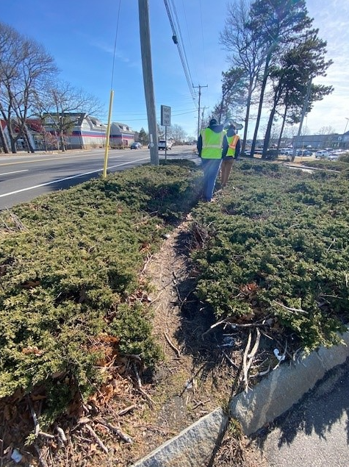
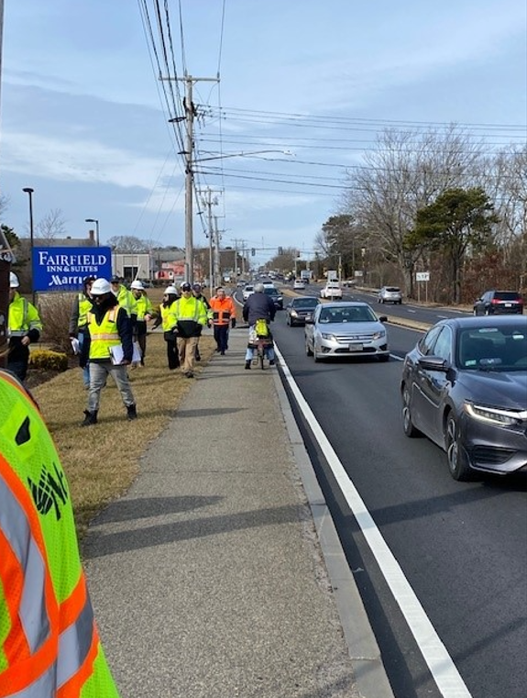
Existing Issues – Route 132
Notes:
Pedestrian desire lines; lack of bicycle infrastructure

Slide 8
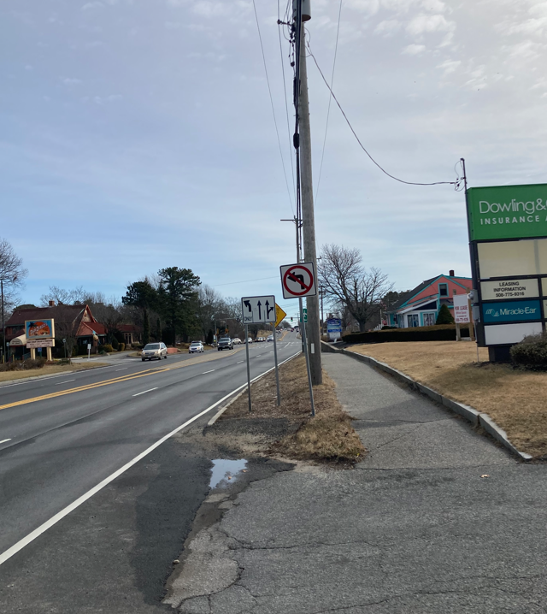
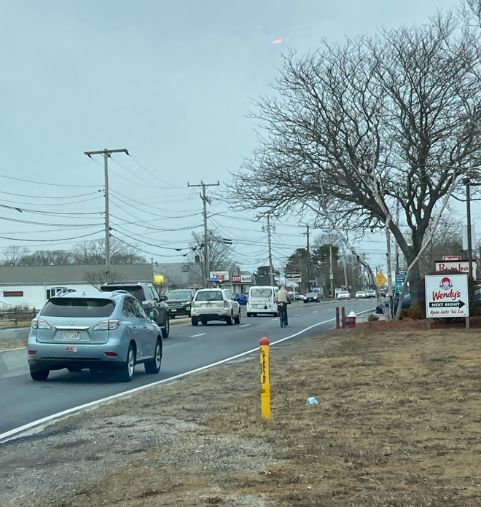
Existing Issues – Route 132
Notes:
Site access control; lack of bicycle infrastructure and substandard roadway width

Slide 9
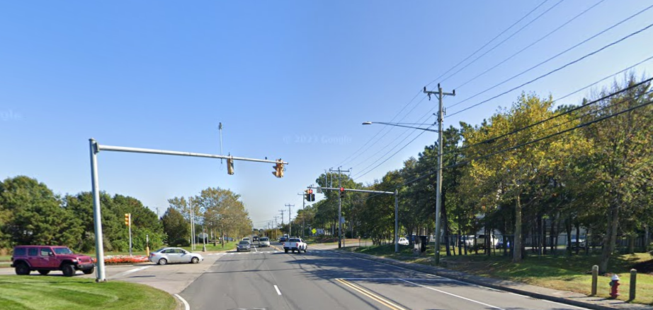
Existing Issues – Route 132
Notes:
Outdated signal equipment; lack of dedicated left turn lane

Slide 10
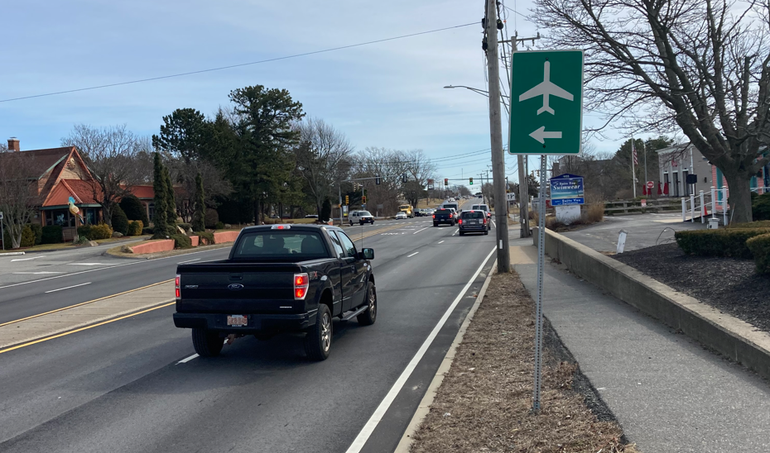
Existing Issues – Route 132
Notes:
Cramped pedestrian accommodations; regional connectivity

Slide 11
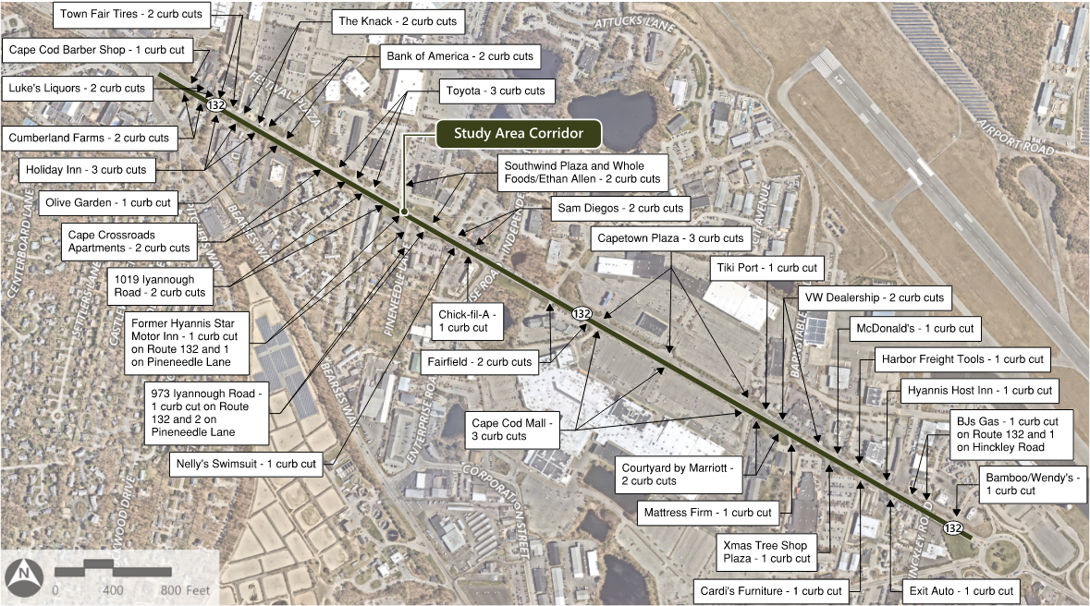
Existing Driveways (Curb Cuts)

Slide 12
Project Goals – Route 132
Construct context sensitive enhancements to the roadway
  Improve pedestrian accommodations
  Improve bicycle facilities
  Integrate CCRTA transit bus stops into project where feasible
Improve signalized intersections
  Standardize lane layout at signal locations
  Reduce congestion
Construct center median for full length of project
Improve pedestrian safety via additional marked crosswalks
Improve driveway definition & access
Improve roadside lighting
Connectivity to regional active transportation networks (Cape Cod Rail Trail)
Notes:
The Barnstable Villager line provides stops at several locations along the corridor, including the Cape Cod Gateway Airport, the Cape Cod Mall, the Capetown Plaza, the Festival Plaza, and Stop and Shop. The Hyannis Crosstown line provides stops at the Cape Cod Mall and the Southwind Plaza, and the Sealine provides a stop at the Cape Cod Mall. It should be noted that all the bus stops in the study area are located within individual parcels and no bus stops are located on Route 132 itself

Slide 13
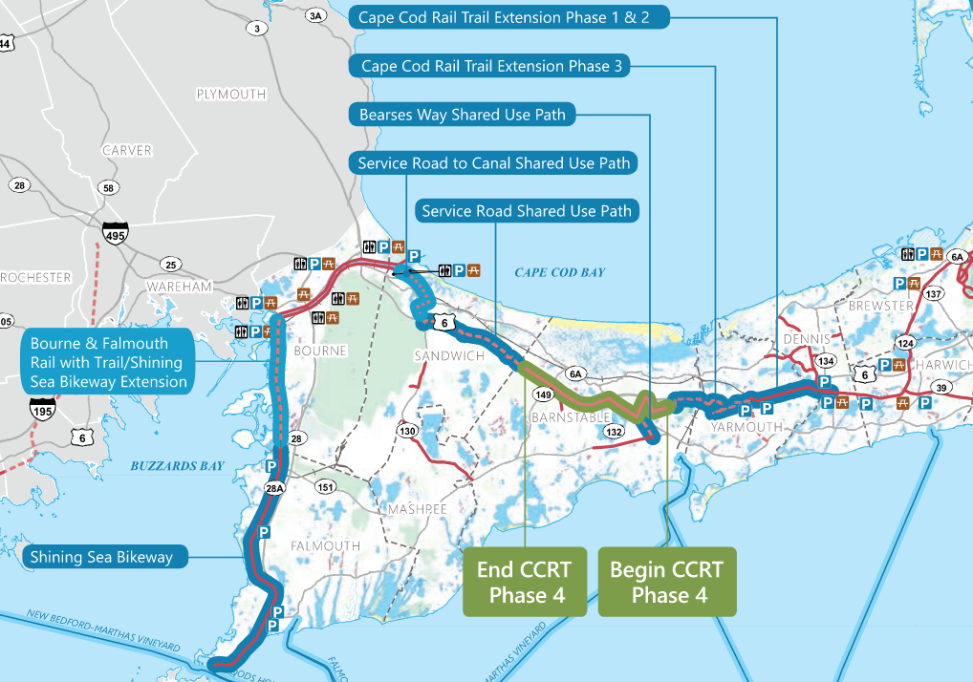
Regional Connectivity
Notes:
The Barnstable Villager line provides stops at several locations along the corridor, including the Cape Cod Gateway Airport, the Cape Cod Mall, the Capetown Plaza, the Festival Plaza, and Stop and Shop. The Hyannis Crosstown line provides stops at the Cape Cod Mall and the Southwind Plaza, and the Sealine provides a stop at the Cape Cod Mall. It should be noted that all the bus stops in the study area are located within individual parcels and no bus stops are located on Route 132 itself

Slide 14
Next Steps
Take feedback from tonight and incorporate ideas into conceptual improvements plan
Develop plan showing improvements to:
  Road layout
  Pedestrian accommodations
  Bicycle accommodations
  Add additional crosswalks
Next Public Meeting – TBD
  No later than MassDOT Design Public Hearing to review preliminary design
Final design of improvements - TBD
Notes:
Sam to speak

Slide 15
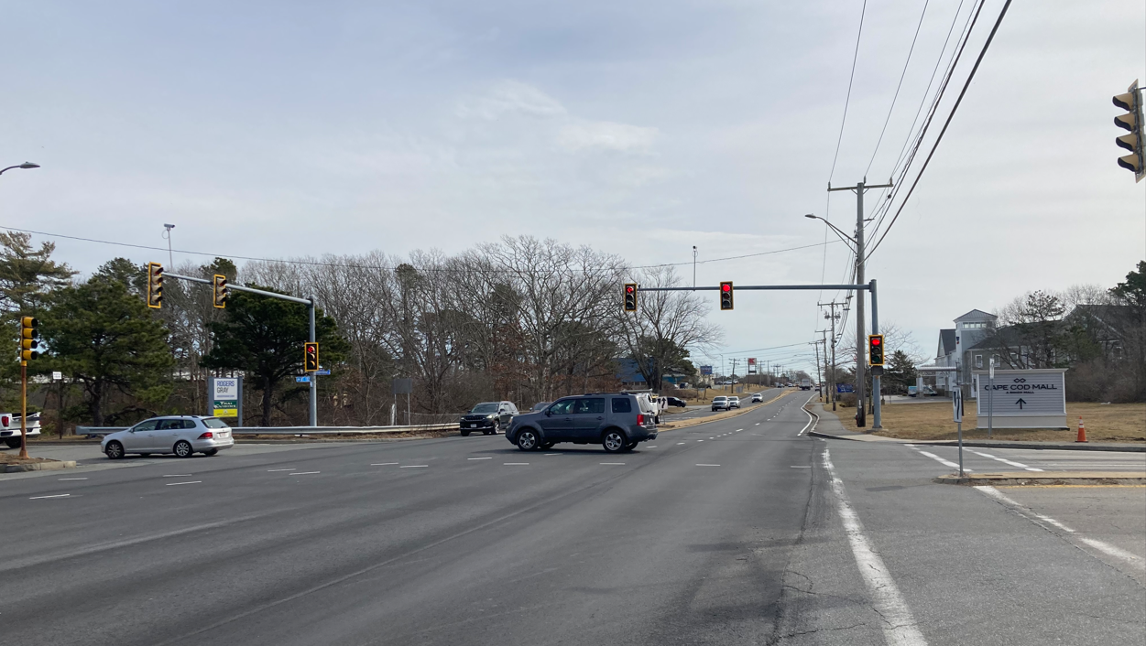
Questions & Answers

Slide 16


Paul Graves | paul.graves@town.barnstable.ma.us | 508.790.6400
Steve Rhoads | srhoads@vhb.com | 617.607.2723
www.vhb.com
Offices located throughout the east coast

Slide 17
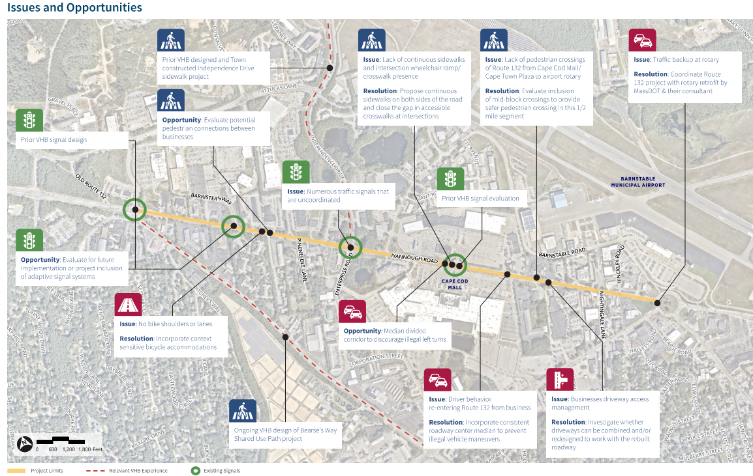

Slide 18
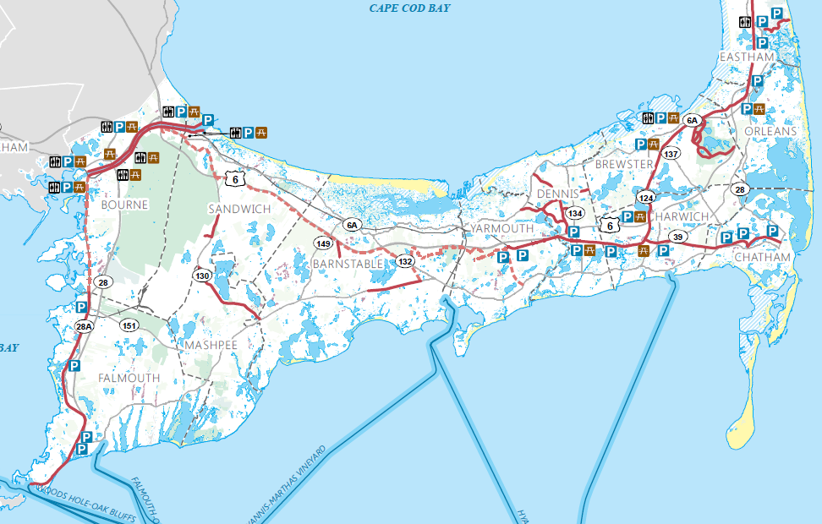
Regional Connections

